Slide 1
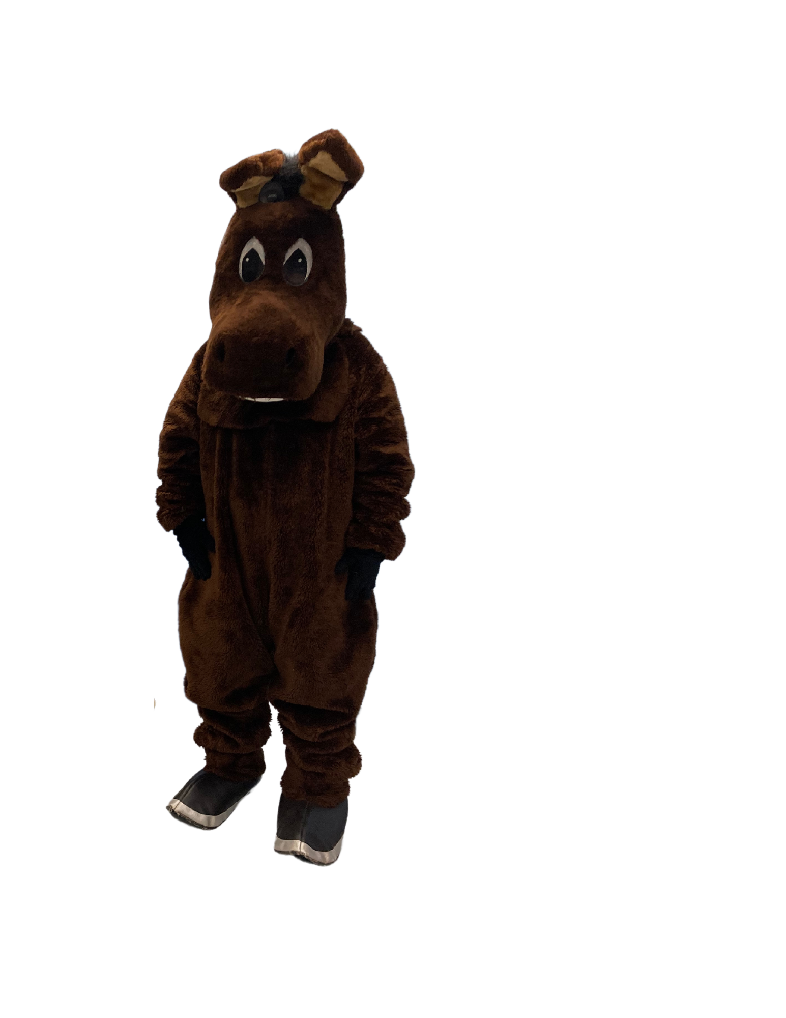
As we go through this power point see if you can find me on each slide!
Adopt-A-Section of the D&L Trail School Program
Updated 2023
- Inspiring Connections Since 1988 -

Slide 2
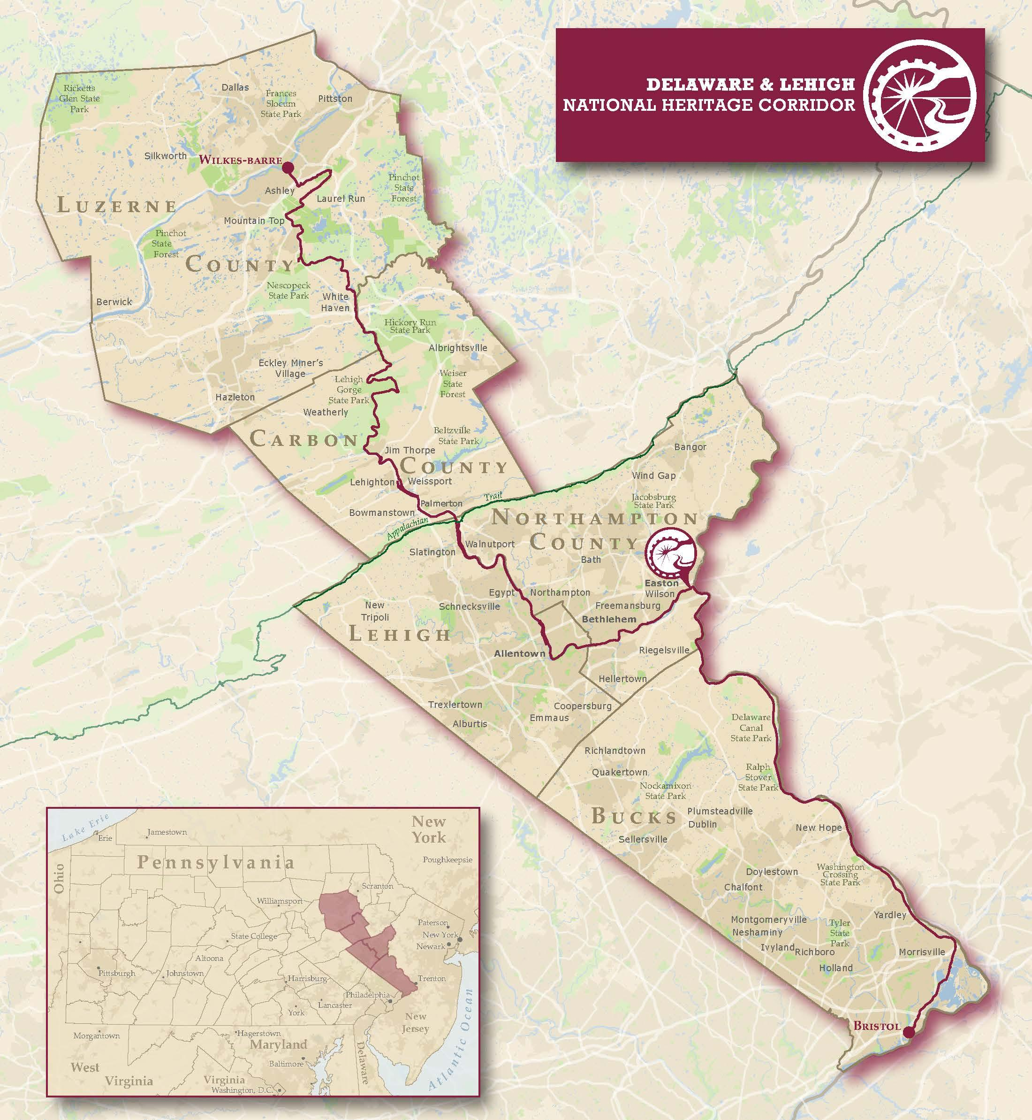
Three Regions of the DLNHC Bristol to Wilkes-Barre 5 Counties 165+ Miles when complete
THE D&L TRAIL
ANTHRACITE REGION
LEHIGH VALLEY REGION
DELAWARE CANAL REGION
Notes:
This shows where we are located and how large we are.

Slide 3
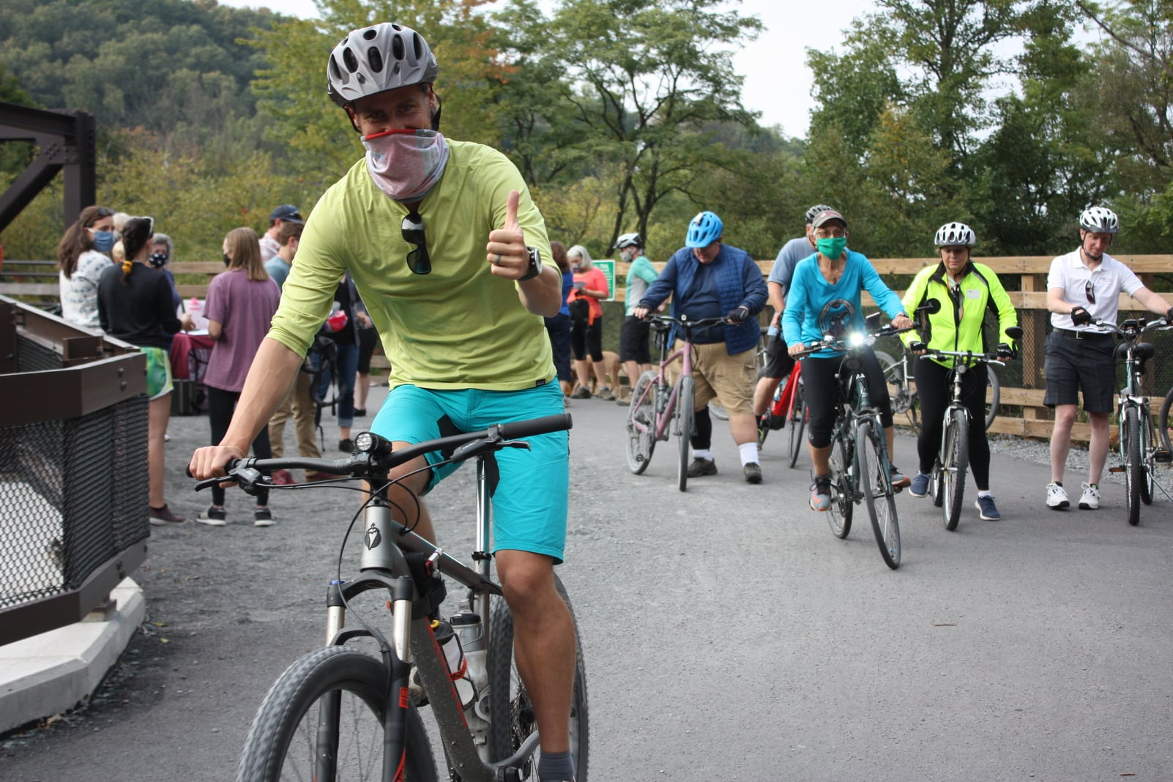
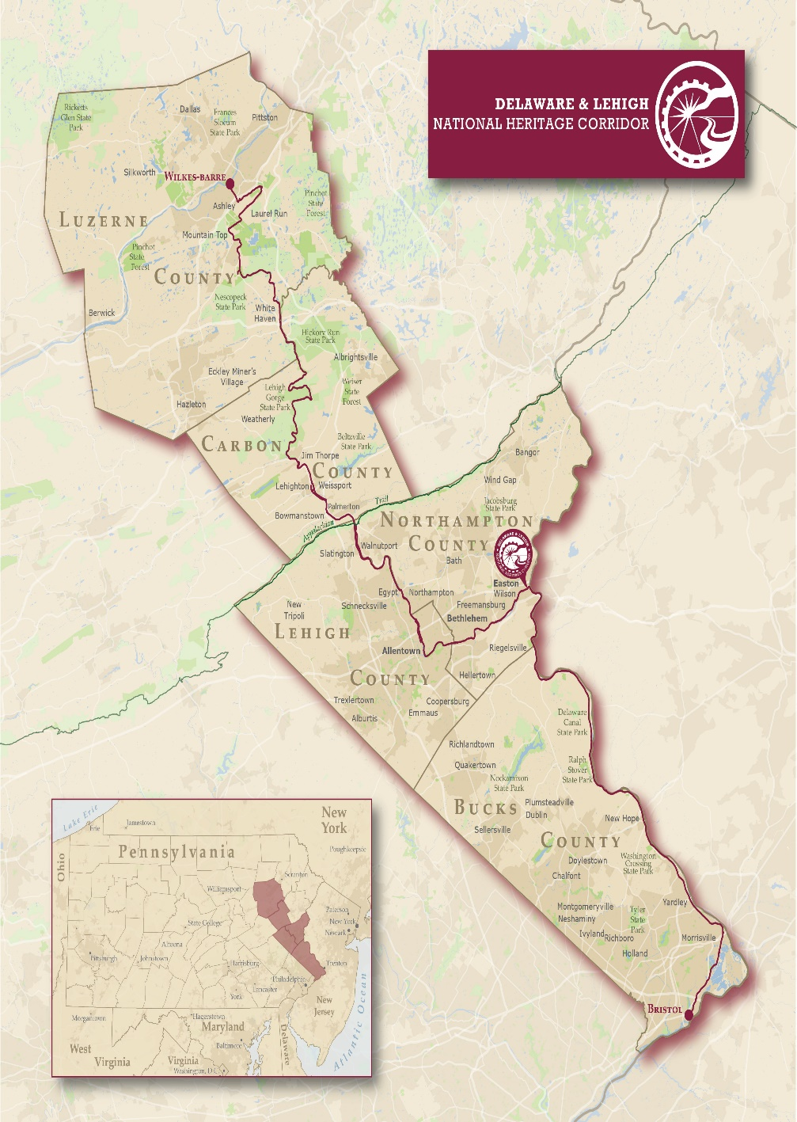
D&L Trail: Longest multi-use trail in PA
Notes:
Multi use means that you can walk or run it but also bike, in some cases ride horses, or ski in the winter. There are also areas along the corridor to access the rivers or watered canal areas.

Slide 4
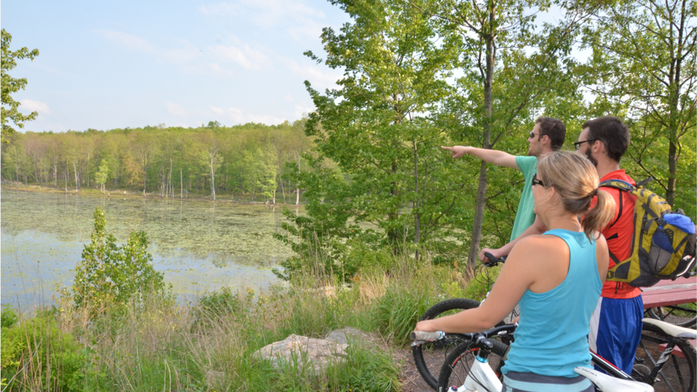
THE D&L TRAIL
WHAT ARE WE?
DLNHC is a Nonprofit- we don't own any trail!
One of 55 National Heritage Areas
Trail is the "spine" of the corridor
30+ local landowners (municipalities, state parks, nonprofits)

Slide 5
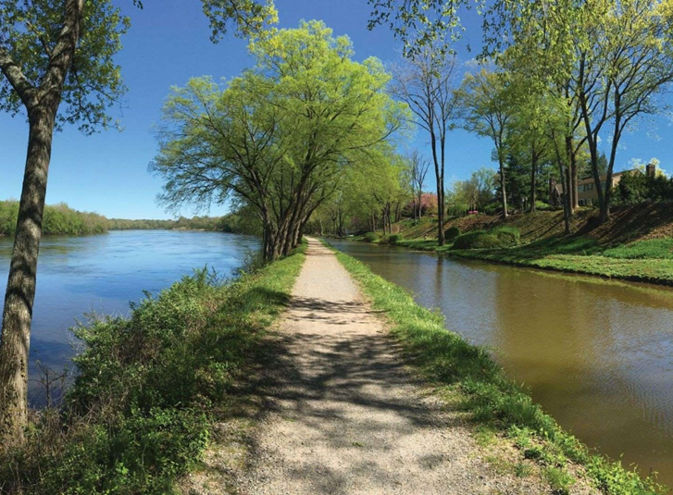
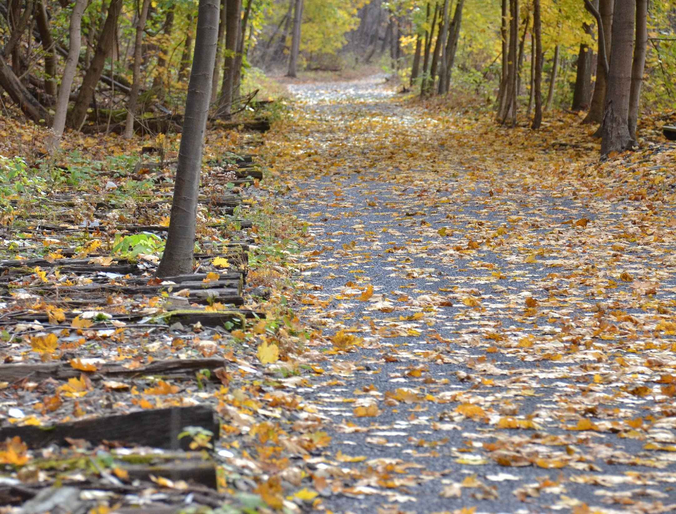
THE D&L TRAIL
CANAL TOWPATH VS. RAIL TRAIL
Canal Towpath—along the historic towpath used by mules to pull the canal boats – often sandwiched between canal and river (Narrower & Steeper Sides)
Rail Trail—built on top of historic railbed that has been removed – often see rail ties next to the trail
(Wider & Flatter Edges)
Notes:
Our trail is made up of both old canal towpaths and rail trails that were once used for transportation networks. That is why they tend to be very flat.

Slide 6
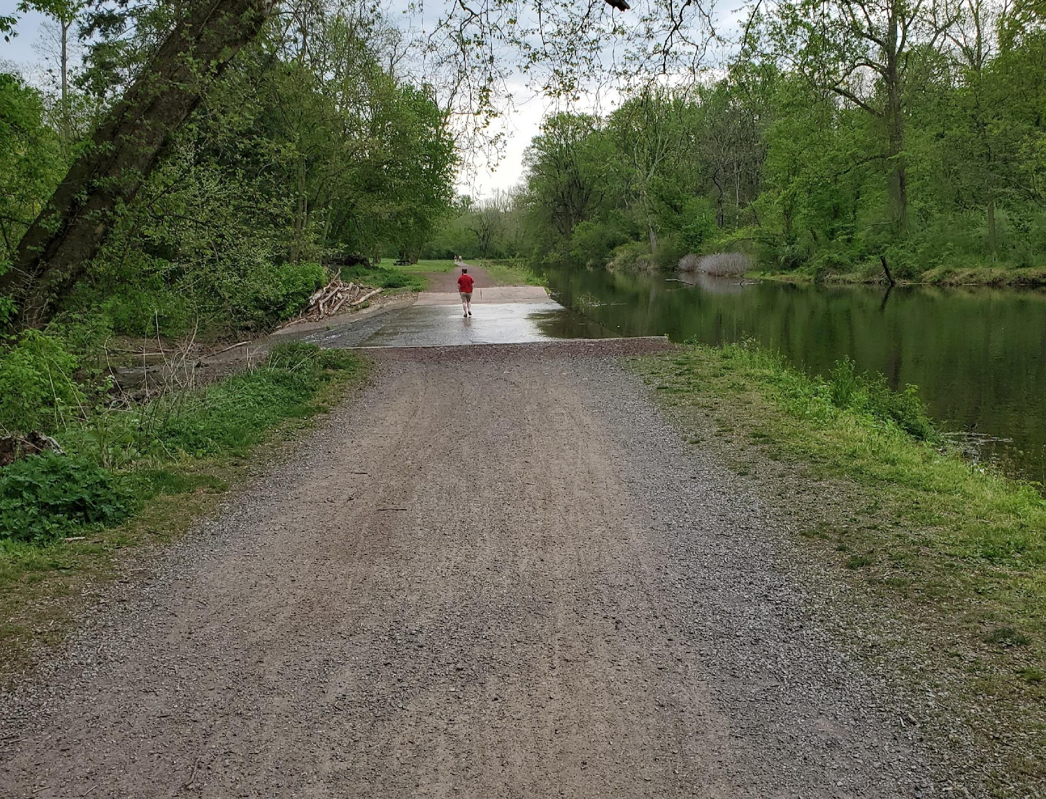
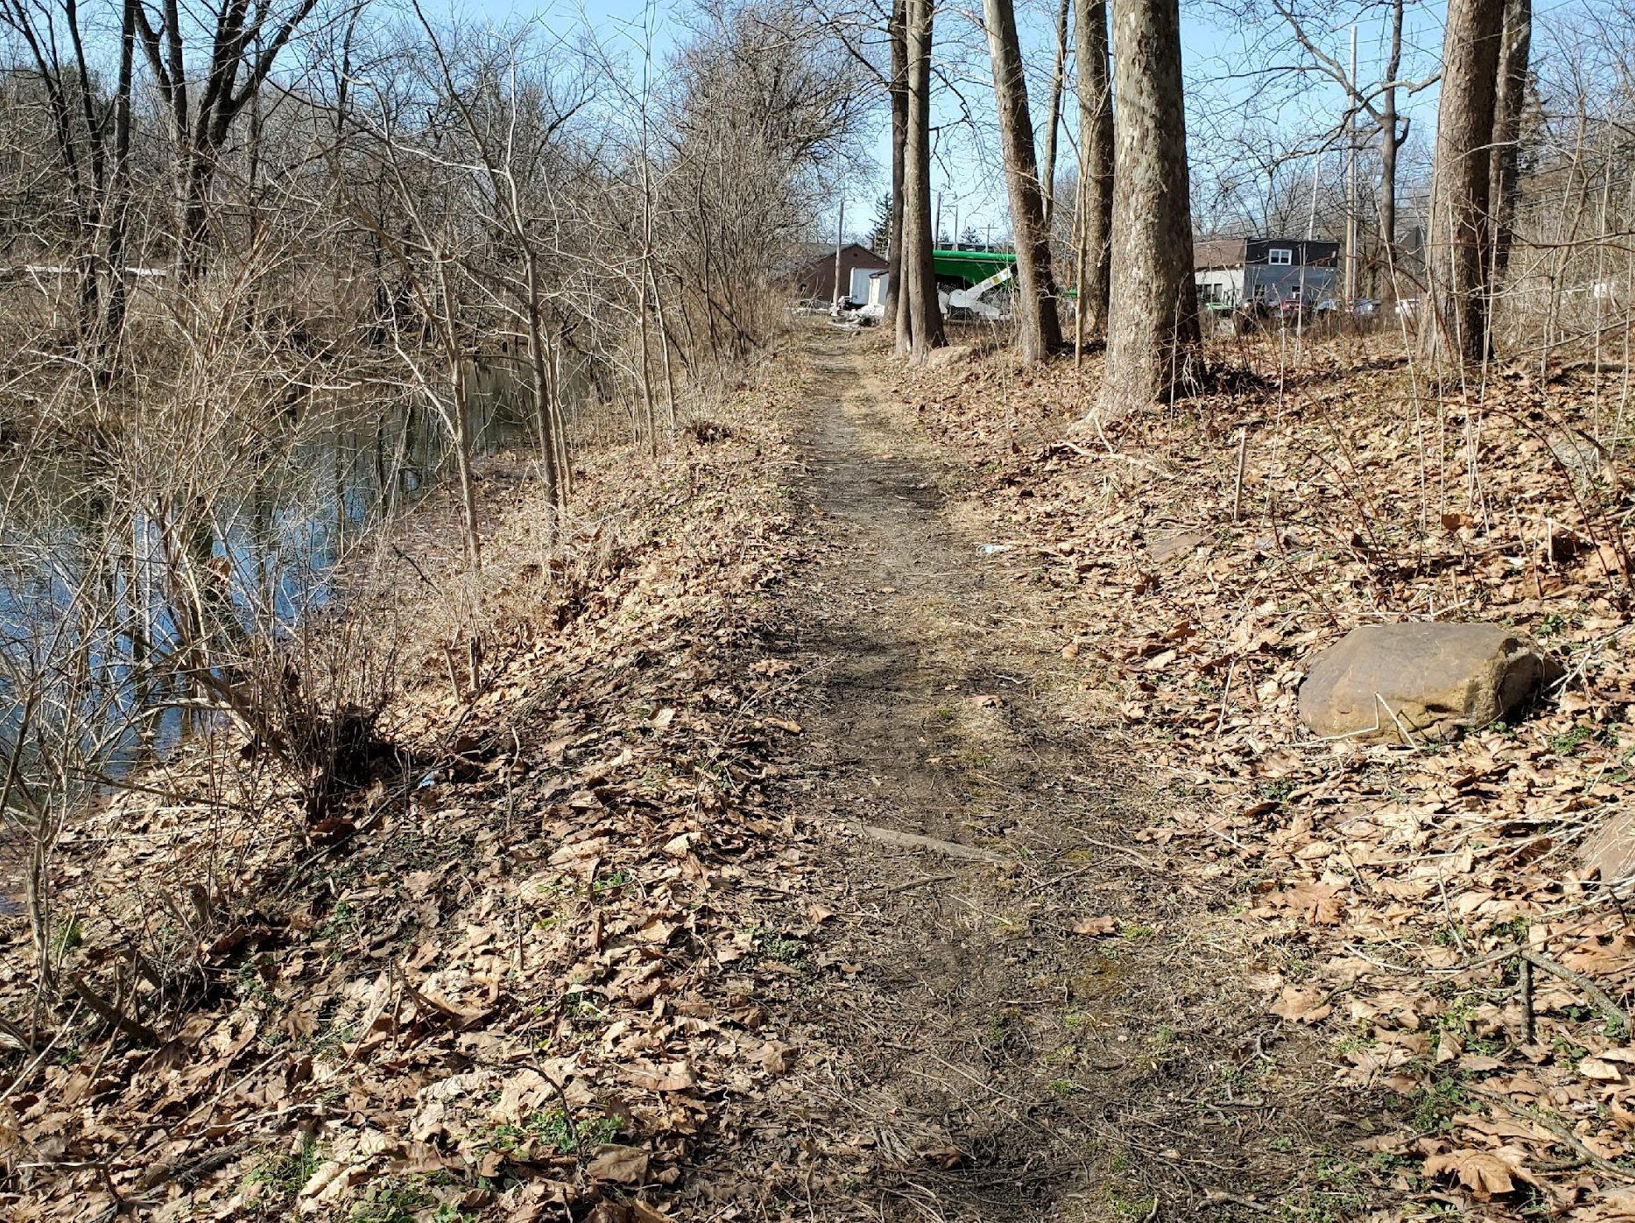
THE D&L TRAIL
TRAIL STATUS
Open & Improved— open to the public- meets D&L standards for width, surface material, and accessibility
Open & Unimproved— open to the public- not yet enhanced for width, surface type, or accessibility
Future—Not open to public yet- future trail planned
Notes:
The section you adopt may be one of the first two options here.

Slide 7
Why Clean Up? Video for younger kids
Notes:
This is appropriate for younger kids, elementary

Slide 8
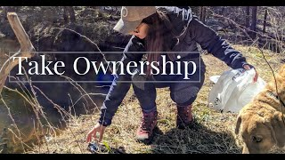
Why Clean Up?
For Older Students
Notes:
This is appropriate for any kids from about 4th grade on. Narrated by a teenager.

Slide 9
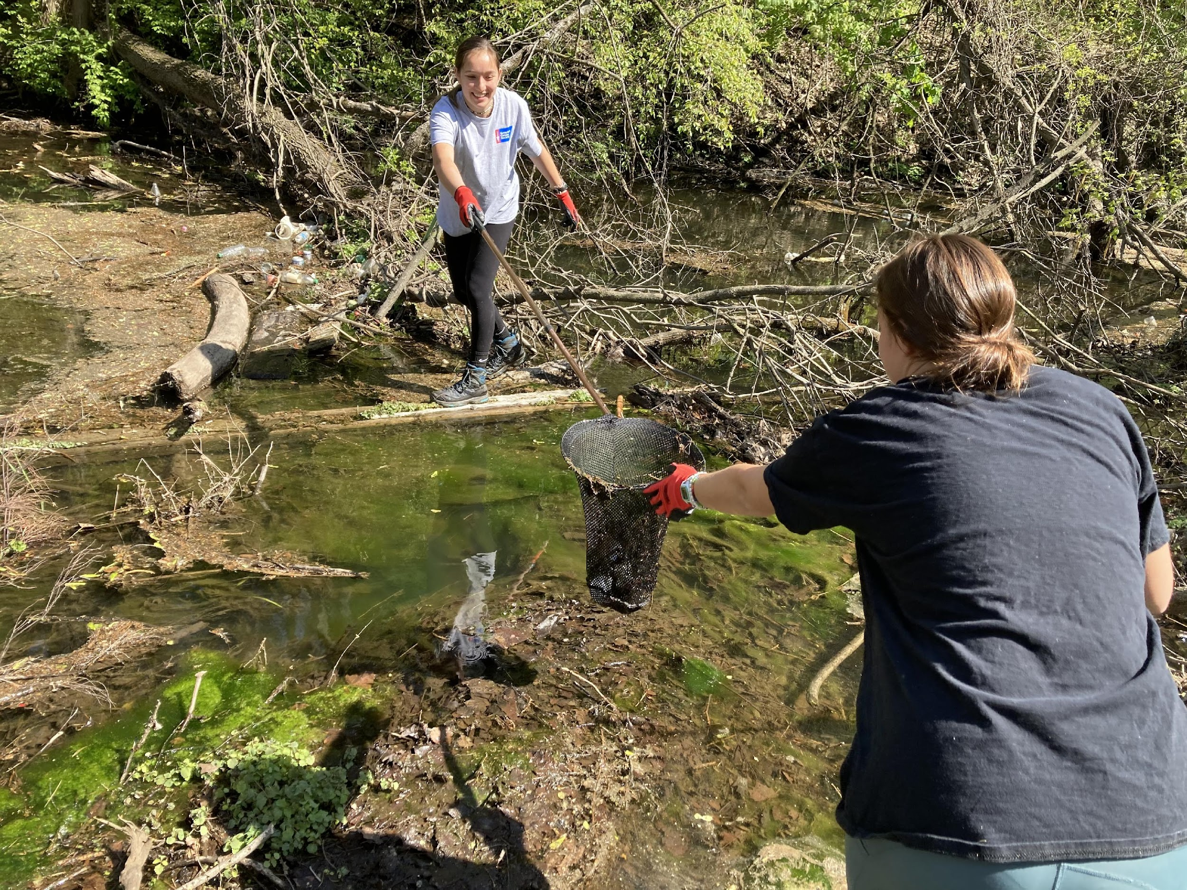
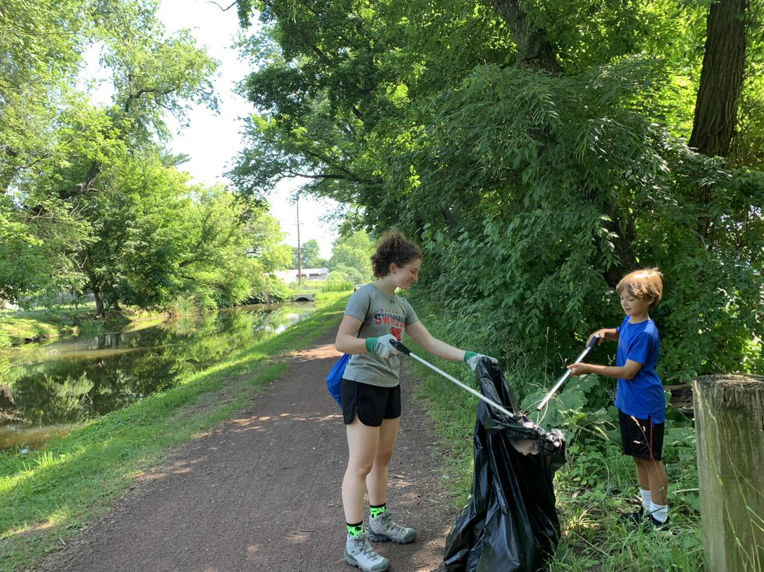
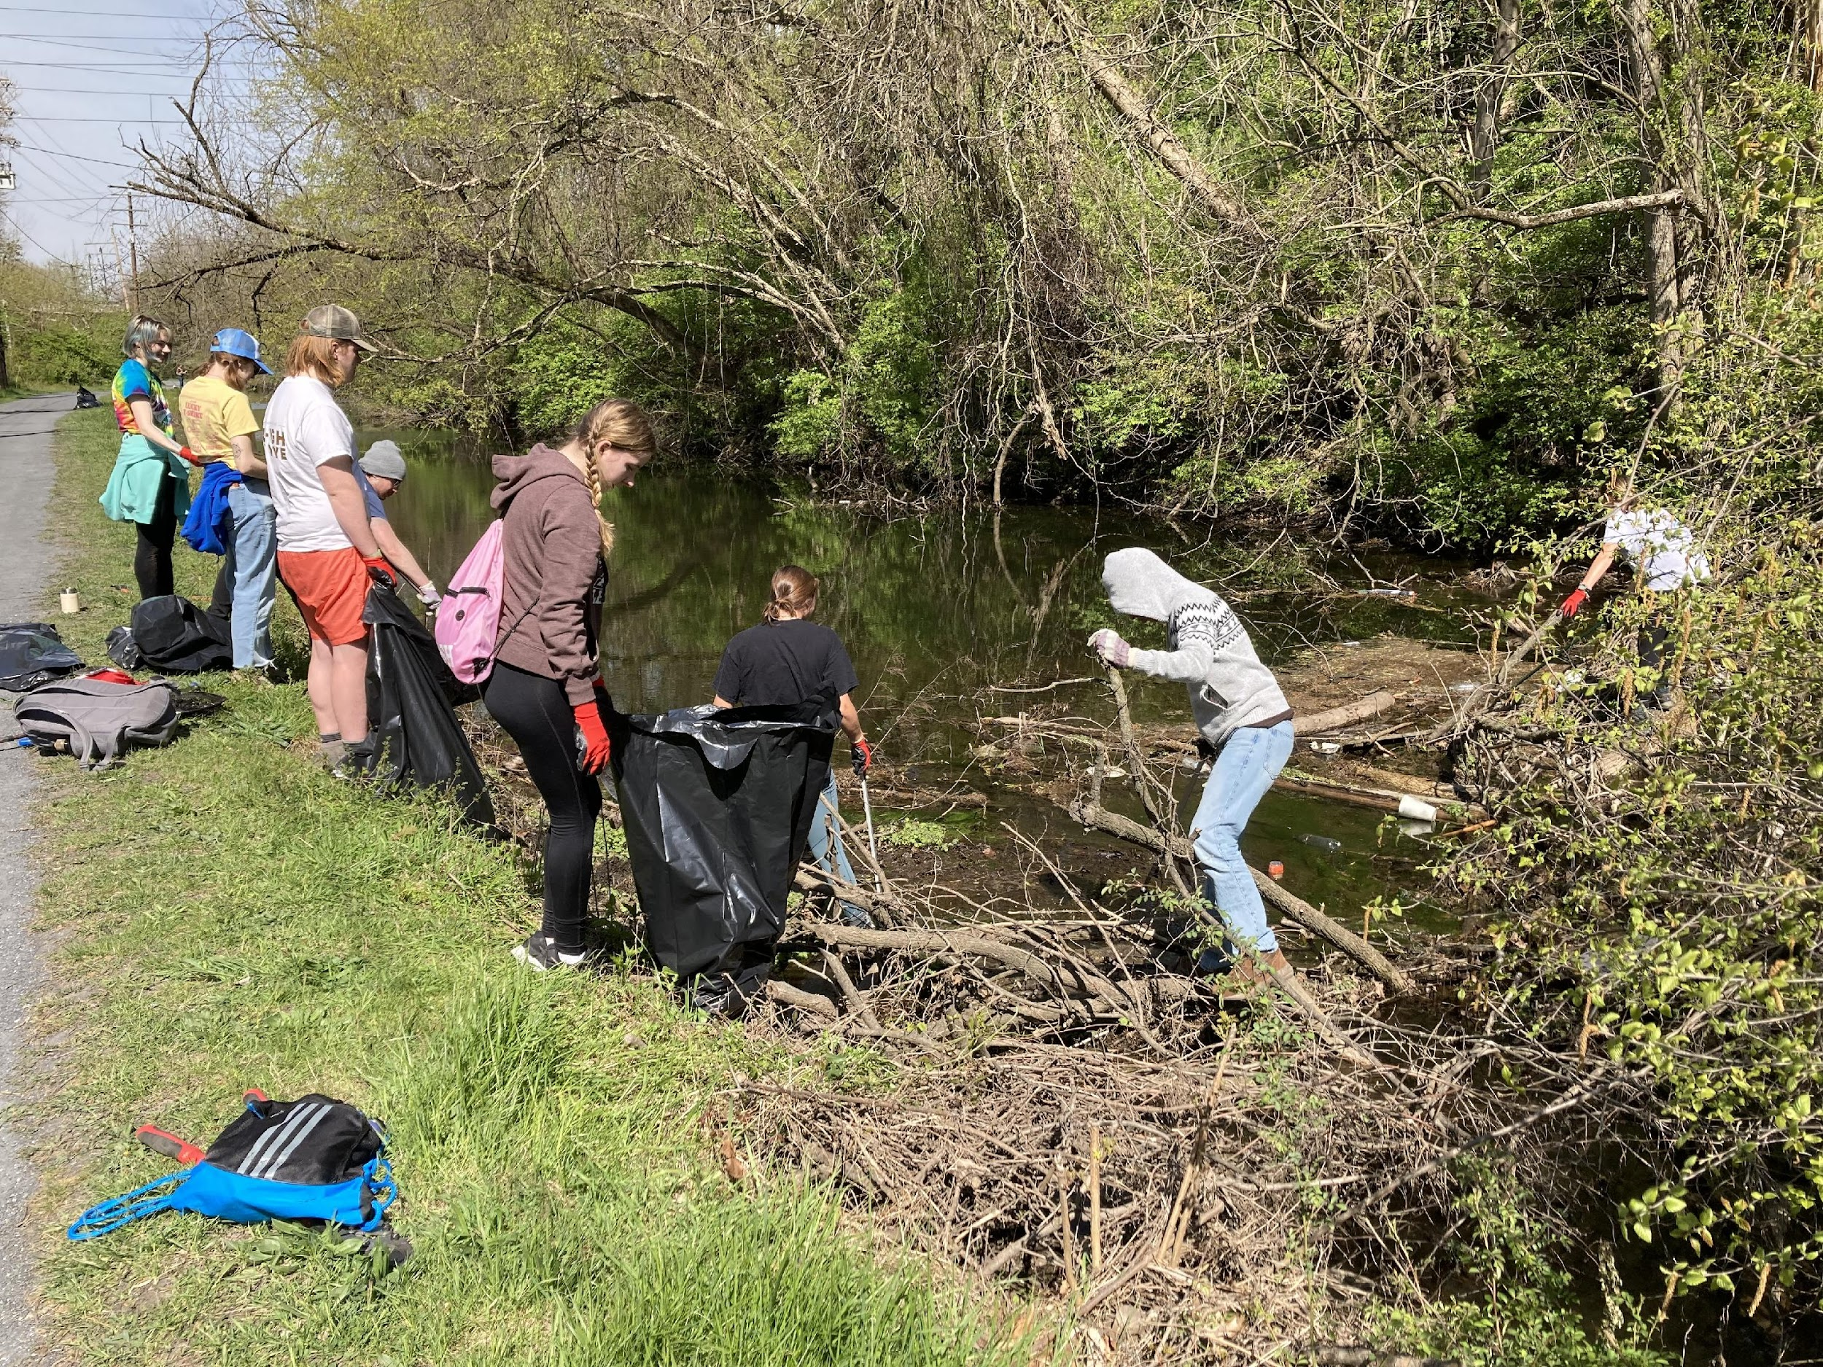
Adopt-A-Section
What tasks will you do?
Trash clean up along path
Cleaning of signs
Removal of brush

Slide 10
Adopt-A-Section
Have a great day!
REPRESENTING THE D&L
YOU are a representative of your organization as well as the D&L! Follow proper etiquette and promote it among trail users
Be friendly – a smile, wave, or hello can go a long way.
Be courteous – respect other trail users regardless of their mode, speed or level of skill.
Be predictable – travel in a consistent and predictable manner.
Be careful – be in control and paying attention especially at pinch points or intersections.
Give an audible warning before passing – bells or say on your left. Try not to startle.
Rails to Trails: Share the Trail https://www.railstotrails.org/experience-trails/share-the-trail/

Slide 11
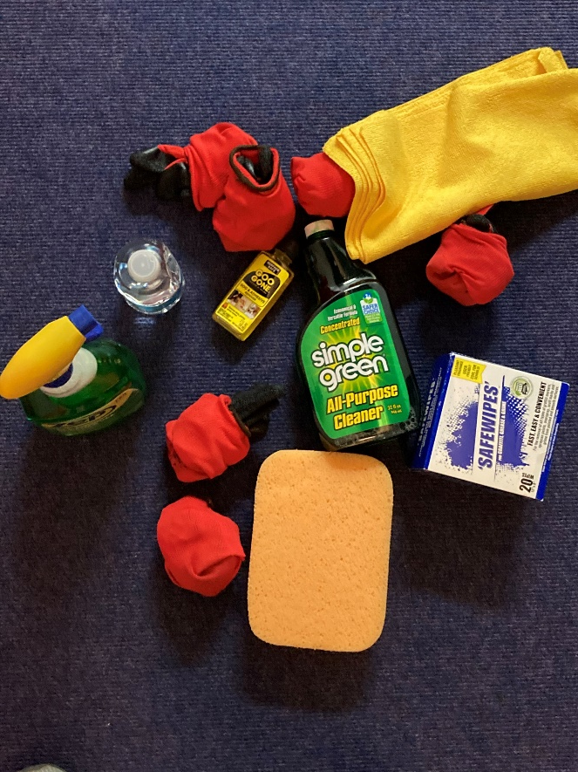
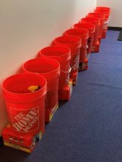
STUFF!!!!
Notes:
These are the types of things that will be given to you by the DLNHC at or before your first clean up.

