Slide 1
Adopt-A-Section of the D&L Trail School Program
Updated 2023
- Inspiring Connections Since 1988 -
Notes:
Claire – hello everyone – what a year it's been since we gathered in Harrisburg weeks before the designation of a global pandemic! Additionally at D&L we've had a few other struggles and sometimes COVID felt like the least of our worries but we hope you'll agree that we continued to move forward as much as possible.

Slide 2
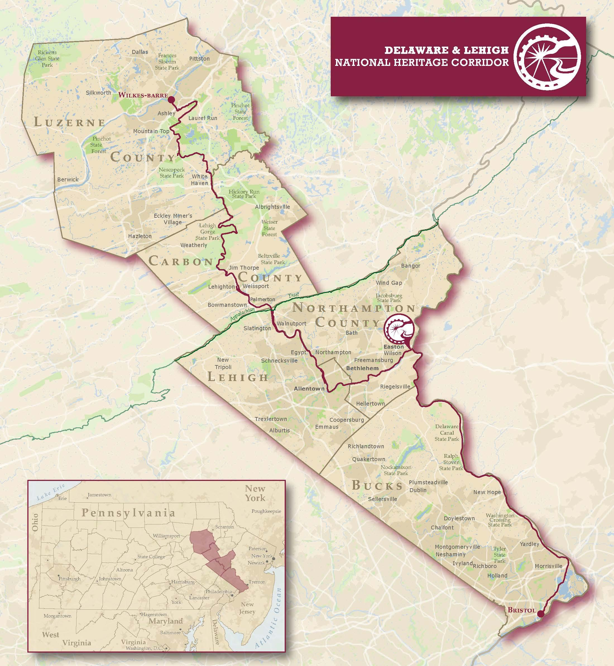
Three Regions of the DLNHC Bristol to Wilkes-Barre 5 Counties 165+ Miles when complete
THE D&L TRAIL
ANTHRACITE REGION
LEHIGH VALLEY REGION
DELAWARE CANAL REGION
Notes:
Claire launces poll: Poll- D&L Trail Community Poll

Slide 3
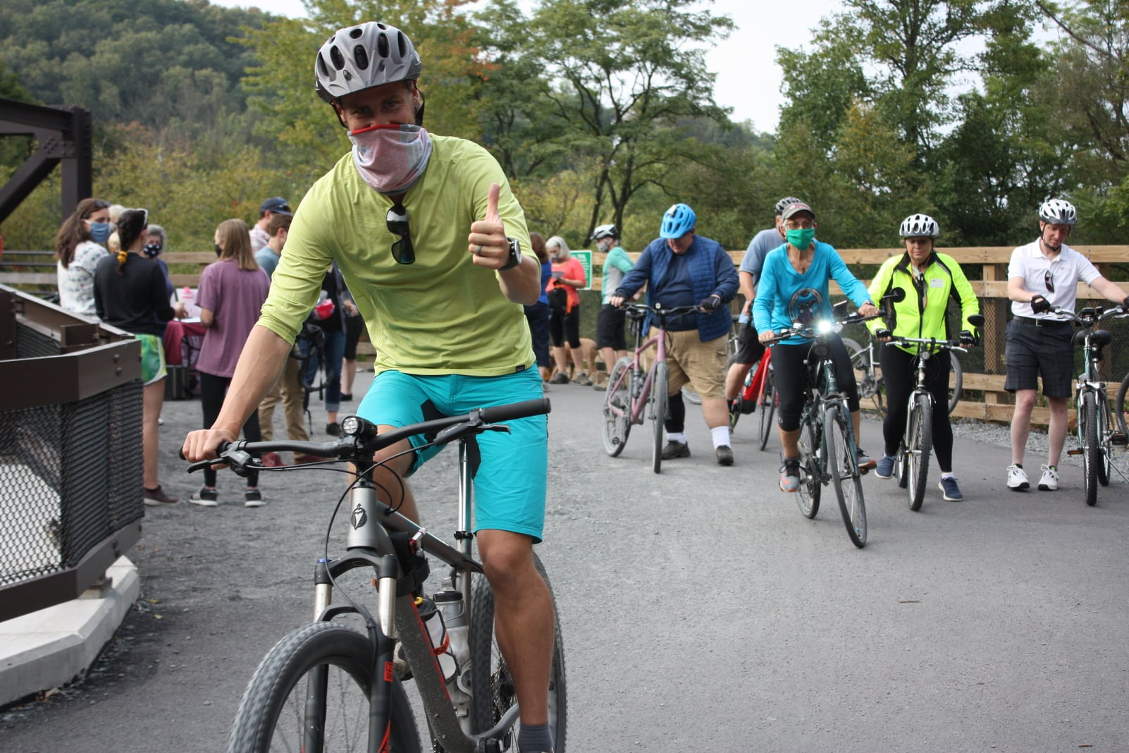
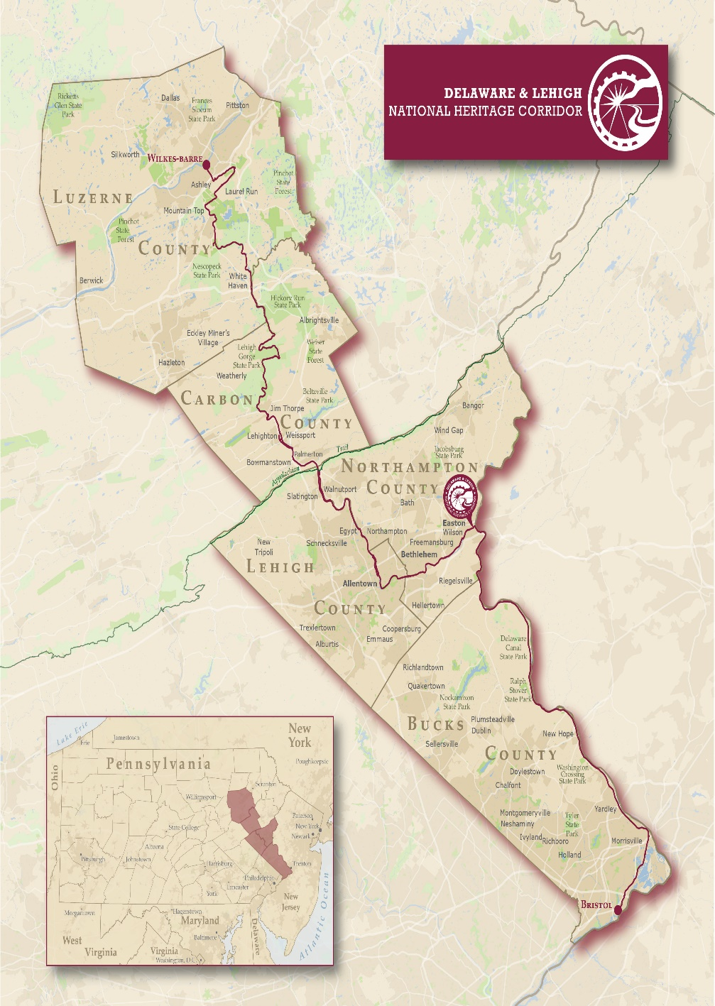
D&L Trail: Longest multi-use trail in PA
Notes:
Claire – our top priority is connecting the D&L Trail to create over 165 miles of connections to history, health, nature, and economic opportunities and these are a few photos of the projects and events from 2020

Slide 4
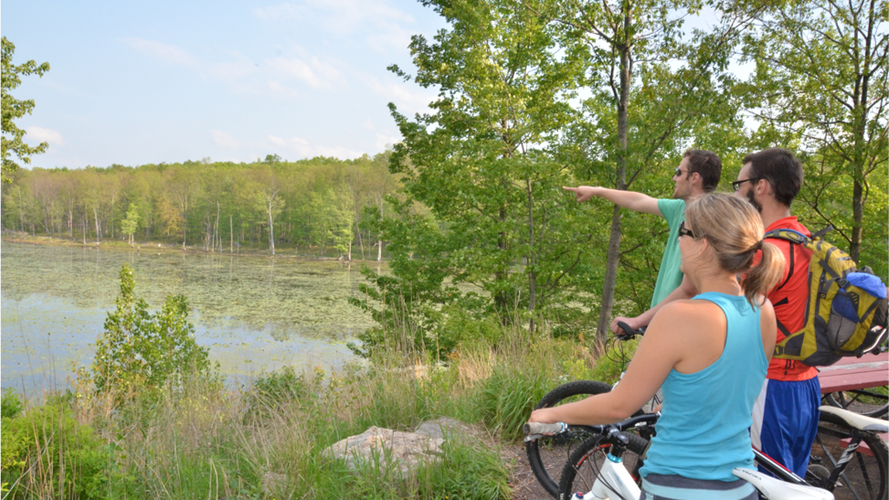
THE D&L TRAIL
WHAT ARE WE?
DLNHC is a Nonprofit- we don't own any trail!
One of 55 National Heritage Areas
Trail is the "spine" of the corridor
30+ local landowners (municipalities, state parks, nonprofits)
Notes:
Claire – we tried to lean into our four pillars of connections: nature and environment, health and wellness, industrial heritage, and economic development
I want to highlight a few of the areas we focused our growth this year within those four pillars:
- mobile app available for free for Apple and Android – already conversing with Devin and FODC on how to incorporate their extensive list of historic structures for public access
- first ever D&L Trail Guidebook was delivered from the printer TODAY – 327 pre-orders already paid for – working with DMOs and TFBs to promote near and far
- we'll talk about trail progress and help needed
- planned more programs to take the museum on the road and get outdoors PLUS implemented full suite of virtual school, family, and general public programs all under new education manager
- helped towns and businesses in new ways (COVID signage along trail, sharing trail use data, notices of open and closed TFBs, promoting trail etiquette, even offering help keeping up with trash at height of the stay at home)
- we're building our suite of concierge and trip-planning resources – had a March webinar about all the resources from the BikeOut curated trips to the webmap and updated regional brochures – recording is available on our facebook page
- and finally we have not forgotten that many sections of trail have been open for years and need regular maintenance so with DCNR support we assisted some landowners with trail maintenance mini grants, completing a canal rehab plan right now for Hugh Moore Park that accounts for towpath stability, and discussing how to build regular funding sources to support D&L Trail stewardship for perpetuity

Slide 5
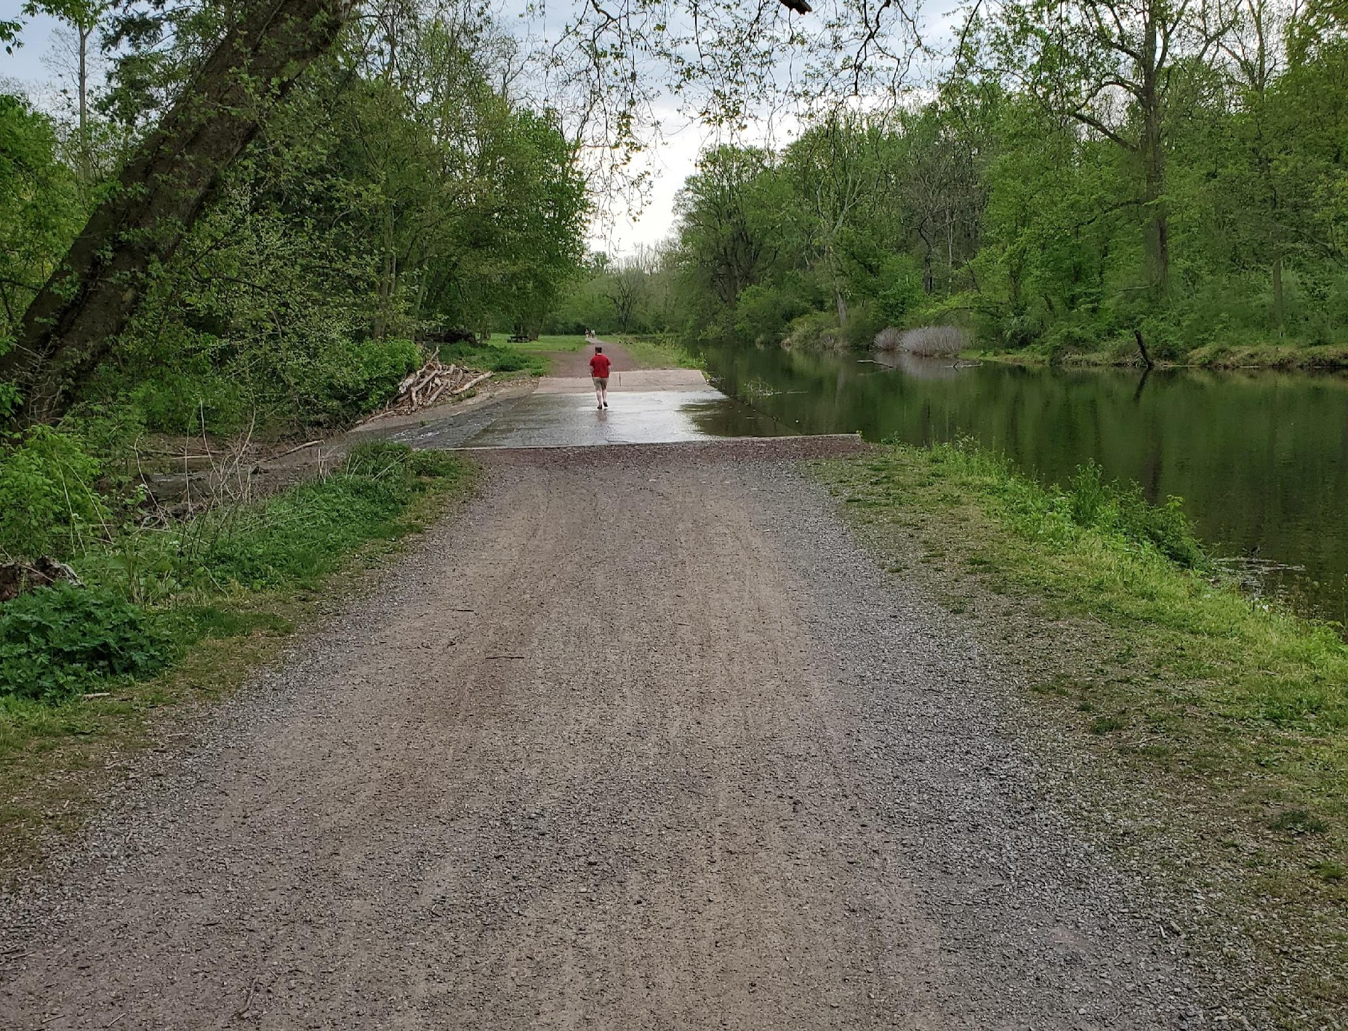
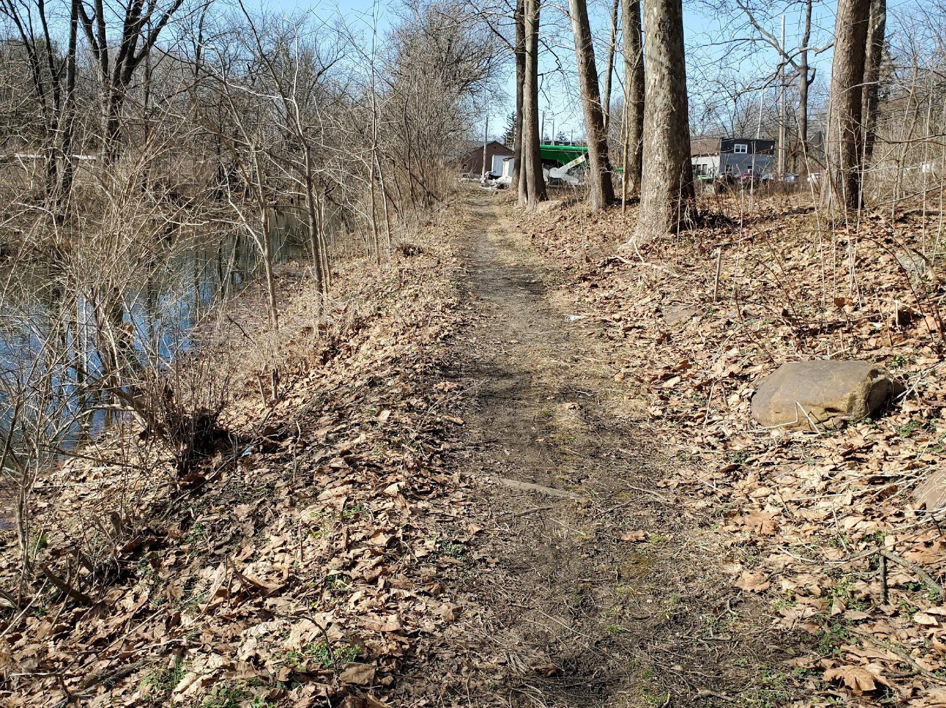
THE D&L TRAIL
TRAIL STATUS
Open & Improved— open to the public- meets D&L standards for width, surface material, and accessibility
Open & Unimproved— open to the public- not yet enhanced for width, surface type, or accessibility
Future—Not open to public yet- future trail planned
Notes:
Claire – we tried to lean into our four pillars of connections: nature and environment, health and wellness, industrial heritage, and economic development
I want to highlight a few of the areas we focused our growth this year within those four pillars:
- mobile app available for free for Apple and Android – already conversing with Devin and FODC on how to incorporate their extensive list of historic structures for public access
- first ever D&L Trail Guidebook was delivered from the printer TODAY – 327 pre-orders already paid for – working with DMOs and TFBs to promote near and far
- we'll talk about trail progress and help needed
- planned more programs to take the museum on the road and get outdoors PLUS implemented full suite of virtual school, family, and general public programs all under new education manager
- helped towns and businesses in new ways (COVID signage along trail, sharing trail use data, notices of open and closed TFBs, promoting trail etiquette, even offering help keeping up with trash at height of the stay at home)
- we're building our suite of concierge and trip-planning resources – had a March webinar about all the resources from the BikeOut curated trips to the webmap and updated regional brochures – recording is available on our facebook page
- and finally we have not forgotten that many sections of trail have been open for years and need regular maintenance so with DCNR support we assisted some landowners with trail maintenance mini grants, completing a canal rehab plan right now for Hugh Moore Park that accounts for towpath stability, and discussing how to build regular funding sources to support D&L Trail stewardship for perpetuity

Slide 6
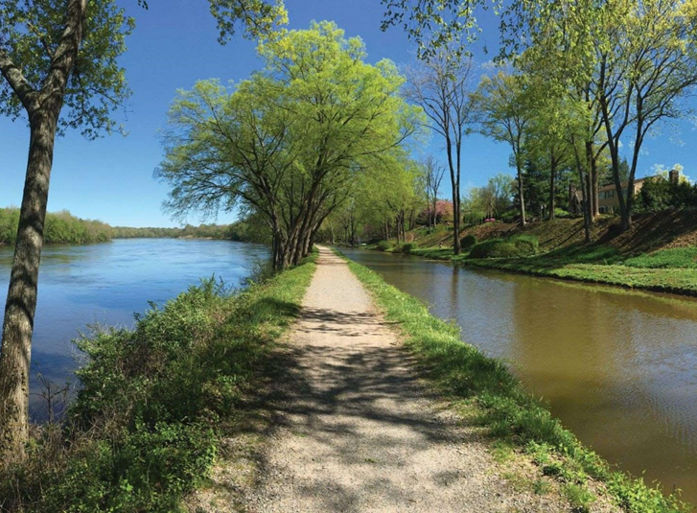
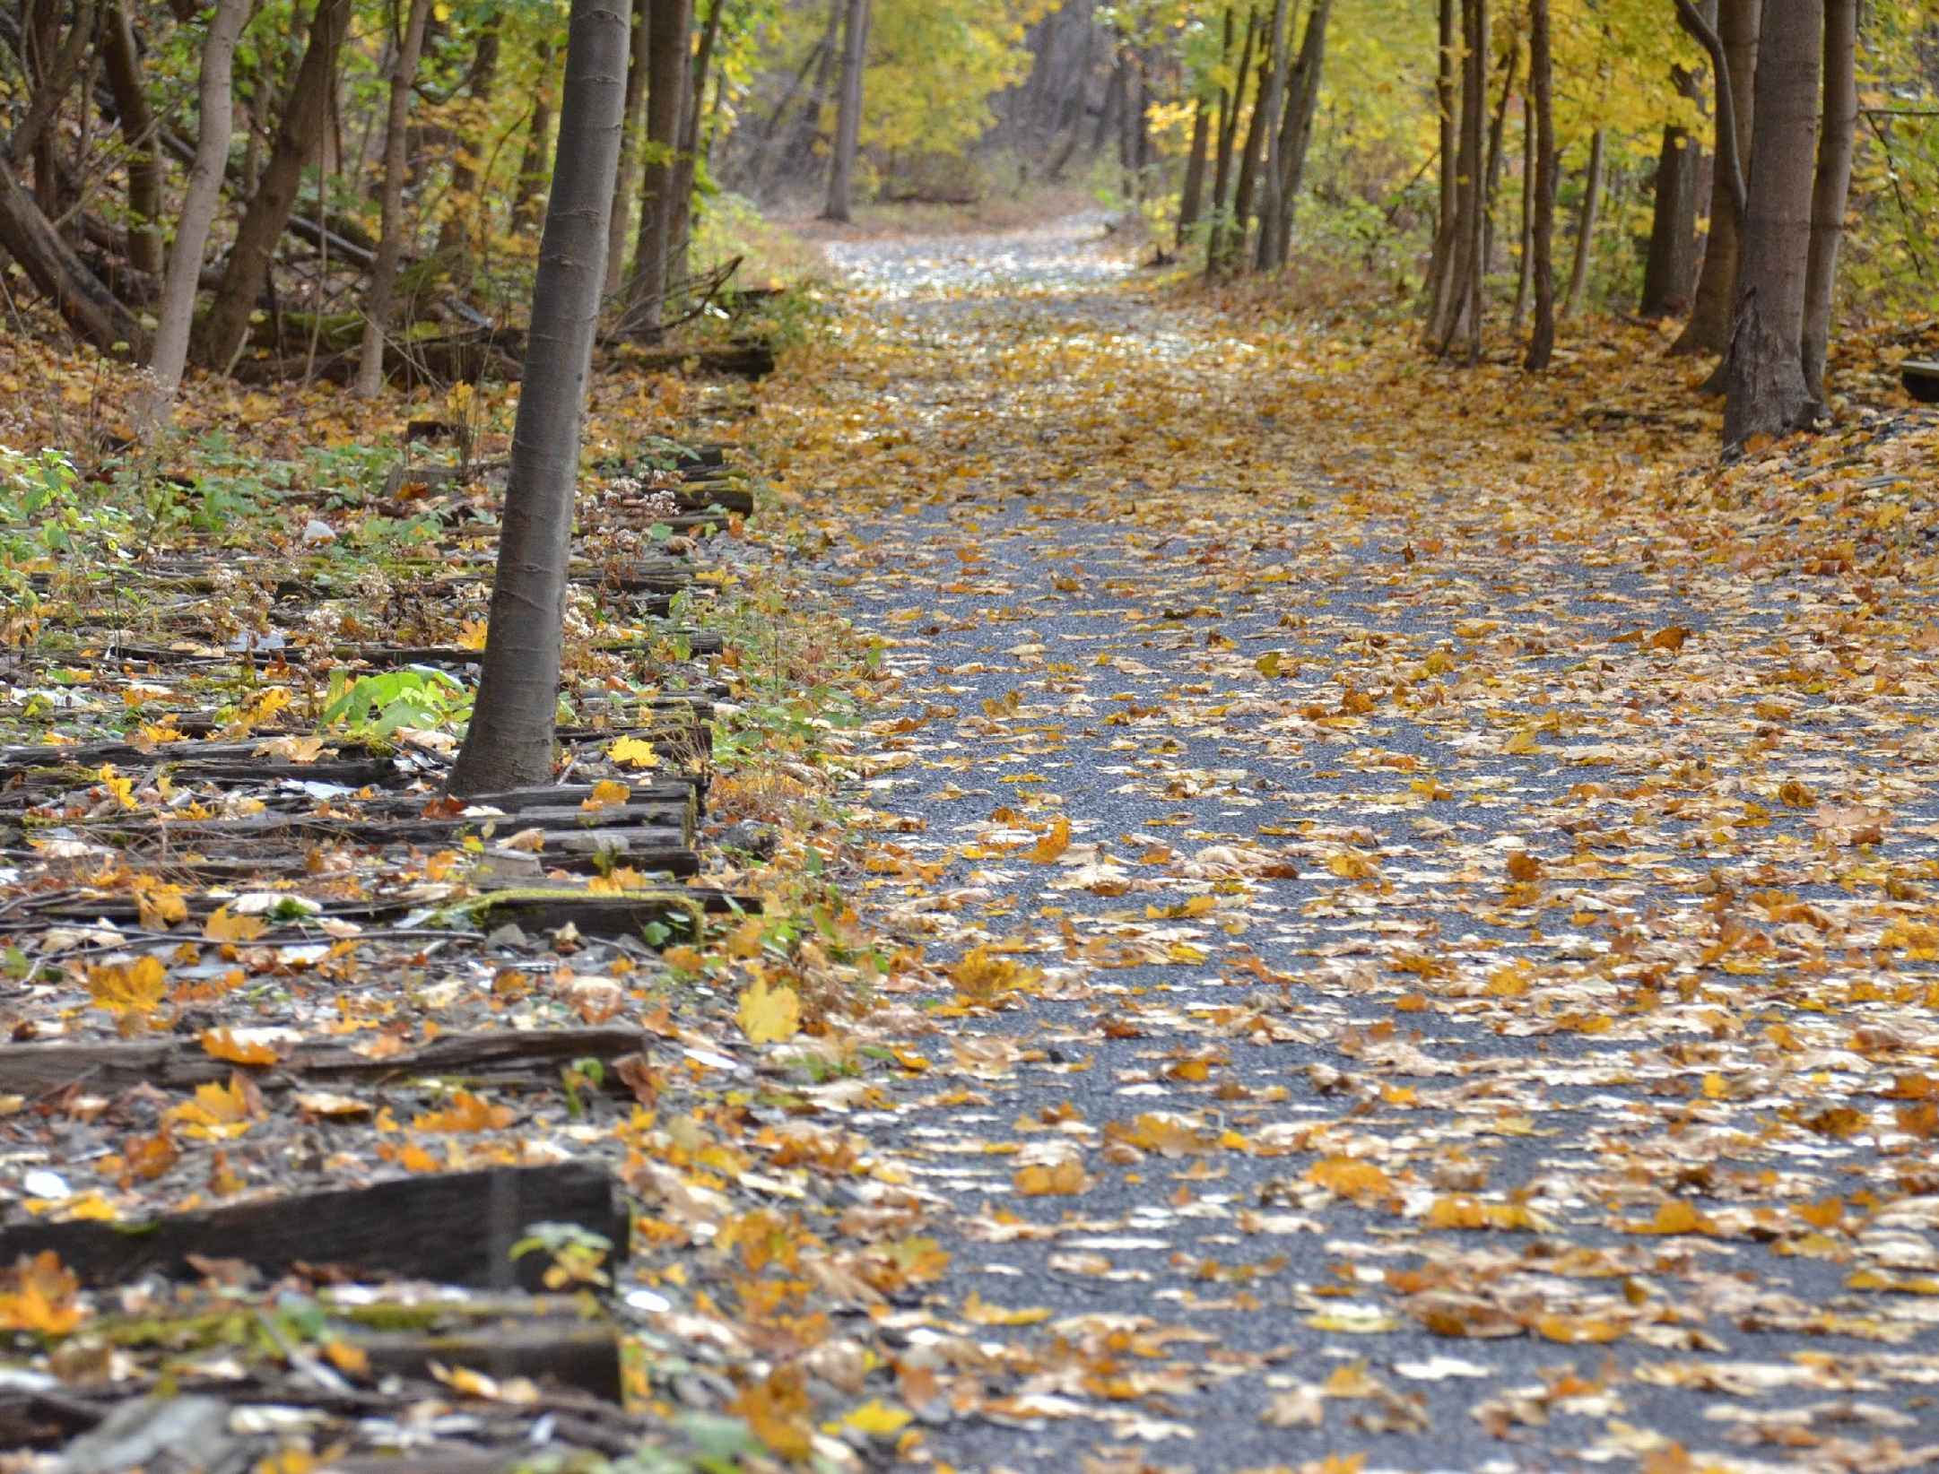
THE D&L TRAIL
CANAL TOWPATH VS. RAIL TRAIL
Canal Towpath—along the historic towpath used by mules to pull the canal boats – often sandwiched between canal and river (Narrower & Steeper Sides)
Rail Trail—built on top of historic railbed that has been removed – often see rail ties next to the trail
(Wider & Flatter Edges)
Notes:
Claire – we tried to lean into our four pillars of connections: nature and environment, health and wellness, industrial heritage, and economic development
I want to highlight a few of the areas we focused our growth this year within those four pillars:
- mobile app available for free for Apple and Android – already conversing with Devin and FODC on how to incorporate their extensive list of historic structures for public access
- first ever D&L Trail Guidebook was delivered from the printer TODAY – 327 pre-orders already paid for – working with DMOs and TFBs to promote near and far
- we'll talk about trail progress and help needed
- planned more programs to take the museum on the road and get outdoors PLUS implemented full suite of virtual school, family, and general public programs all under new education manager
- helped towns and businesses in new ways (COVID signage along trail, sharing trail use data, notices of open and closed TFBs, promoting trail etiquette, even offering help keeping up with trash at height of the stay at home)
- we're building our suite of concierge and trip-planning resources – had a March webinar about all the resources from the BikeOut curated trips to the webmap and updated regional brochures – recording is available on our facebook page
- and finally we have not forgotten that many sections of trail have been open for years and need regular maintenance so with DCNR support we assisted some landowners with trail maintenance mini grants, completing a canal rehab plan right now for Hugh Moore Park that accounts for towpath stability, and discussing how to build regular funding sources to support D&L Trail stewardship for perpetuity

Slide 7
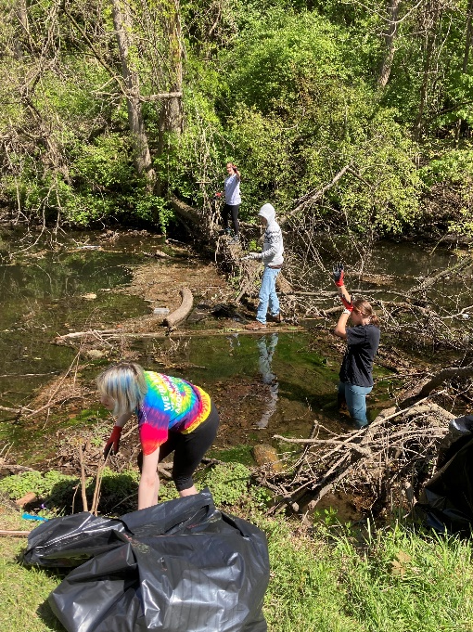
THE D&L TRAIL
Trail Tenders- Existing Umbrella Program
D&L Trail Tenders​
Our "umbrella" program for levels of volunteer engagement in trail stewardship activities—including litter removal, brush clearing, signage care, painting amenities, planting, and more​
Public DLNHC-led events​ with larger groups
Partner-led “one time” events in coordination with DLNHC and landowners​
Adopt-a-Section of D&L Trail
First step for individuals interested in volunteering-​
https://delawareandlehigh.org/volunteer/​
Tenders, Adopt-A-Section, Museum Docents and More.
​
Notes:
Claire – we tried to lean into our four pillars of connections: nature and environment, health and wellness, industrial heritage, and economic development
I want to highlight a few of the areas we focused our growth this year within those four pillars:
- mobile app available for free for Apple and Android – already conversing with Devin and FODC on how to incorporate their extensive list of historic structures for public access
- first ever D&L Trail Guidebook was delivered from the printer TODAY – 327 pre-orders already paid for – working with DMOs and TFBs to promote near and far
- we'll talk about trail progress and help needed
- planned more programs to take the museum on the road and get outdoors PLUS implemented full suite of virtual school, family, and general public programs all under new education manager
- helped towns and businesses in new ways (COVID signage along trail, sharing trail use data, notices of open and closed TFBs, promoting trail etiquette, even offering help keeping up with trash at height of the stay at home)
- we're building our suite of concierge and trip-planning resources – had a March webinar about all the resources from the BikeOut curated trips to the webmap and updated regional brochures – recording is available on our facebook page
- and finally we have not forgotten that many sections of trail have been open for years and need regular maintenance so with DCNR support we assisted some landowners with trail maintenance mini grants, completing a canal rehab plan right now for Hugh Moore Park that accounts for towpath stability, and discussing how to build regular funding sources to support D&L Trail stewardship for perpetuity

Slide 8
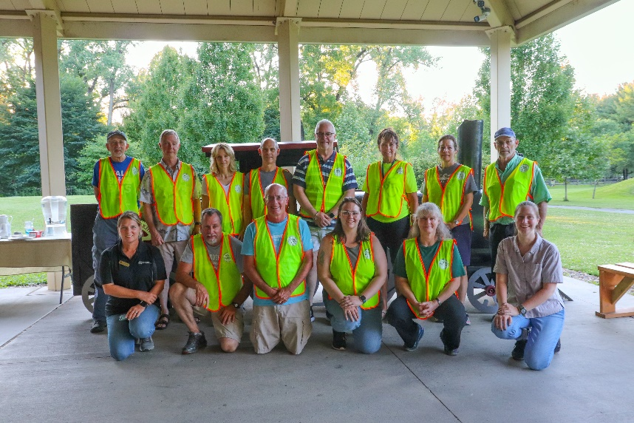
THE D&L TRAIL
WHAT IS A TRAIL PATROLLER? Existing Program
Through this program, volunteers serve as ambassadors for the trail. They patrol the trail on bicycle or foot at least twice a month, April through October, in all five counties answering visitors’ questions and reporting back about fallen trees, erosion, and trail maintenance issues.
Volunteers can join at the Informal and Formal level depending on desired commitment. Formal volunteers report issues via a webform and are required to attend a training event where they can learn about the trail, how to help trail users, and what to report.
Notes:
Liz

Slide 9
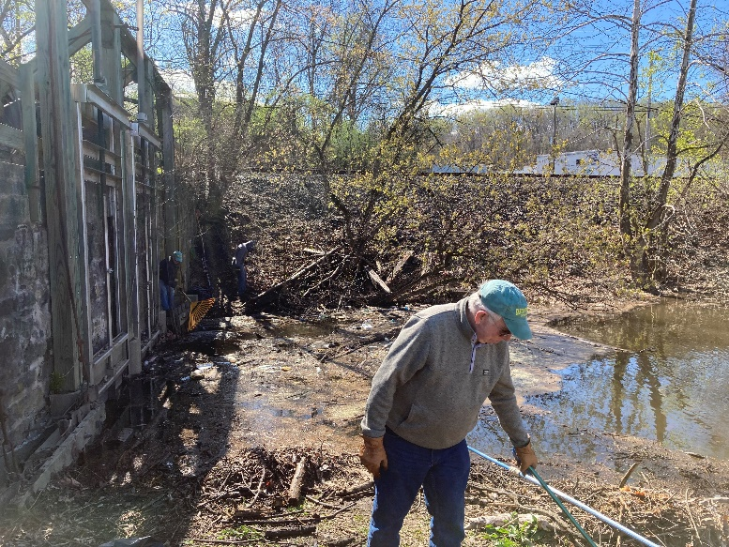
Adopt-A-Section
Overview
How It Works
D&L’s Adopt-A-Trail program enables volunteers to become a steward of a specific section of trail and are responsible for performing basic maintenance on that trail. Requirements include training, tending to the trail at least once a month, cleaning signs once a year and re-certifying every 2 years.
School Program
This program is very similar to the public Adopt-A-Trail program. However, we work with the schools to be as flexible as possible. Sign ups and trainings are year round, based on the needs of the school. While we hope that schools can tend their mile of trail monthly, we understand that there will be some months that this is not possible. We re-certify each year as each new school year begins.
Notes:
Claire – we tried to lean into our four pillars of connections: nature and environment, health and wellness, industrial heritage, and economic development
I want to highlight a few of the areas we focused our growth this year within those four pillars:
- mobile app available for free for Apple and Android – already conversing with Devin and FODC on how to incorporate their extensive list of historic structures for public access
- first ever D&L Trail Guidebook was delivered from the printer TODAY – 327 pre-orders already paid for – working with DMOs and TFBs to promote near and far
- we'll talk about trail progress and help needed
- planned more programs to take the museum on the road and get outdoors PLUS implemented full suite of virtual school, family, and general public programs all under new education manager
- helped towns and businesses in new ways (COVID signage along trail, sharing trail use data, notices of open and closed TFBs, promoting trail etiquette, even offering help keeping up with trash at height of the stay at home)
- we're building our suite of concierge and trip-planning resources – had a March webinar about all the resources from the BikeOut curated trips to the webmap and updated regional brochures – recording is available on our facebook page
- and finally we have not forgotten that many sections of trail have been open for years and need regular maintenance so with DCNR support we assisted some landowners with trail maintenance mini grants, completing a canal rehab plan right now for Hugh Moore Park that accounts for towpath stability, and discussing how to build regular funding sources to support D&L Trail stewardship for perpetuity

Slide 10
Adopt-A-Section
What Trail Tasks Are Expected?
Monthly Litter Clean Up and coordination of trash removal
Annual Sign Cleaning
As- needed brush trimming with hand tools (if age appropriate and comfortable)
What Other Tasks Are Expected?
Sign Agreement
Semester Reporting of Volunteer Hours to D&L
Communication with the Landowners for permits or permission for clean up.
Recommitting every school year (may include additional training).

Slide 11
Adopt-A-Section
How the Staff at D&L provides support
We appreciate and value you and are here to help!
Help connect volunteers with public landowners
Loan Tools
Provide expertise
Provide cleaning supplies.
Highlight Groups on Social media, D&L website and email blasts.
Future Potential: Signage recognizing
adopters

Slide 12
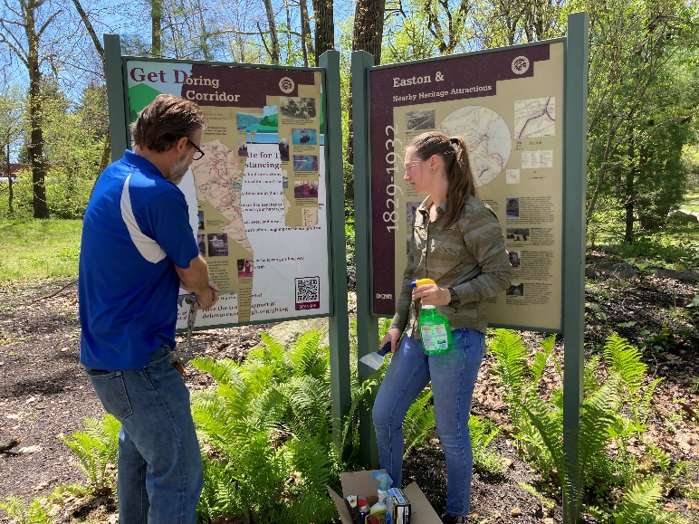
Adopt-A-Section
Coordinate with Landowners (Example)
The following 3 slides are examples of the paperwork with a landowner. Each landowner is different and may require different things.
Often a landowner is a town, township or municipality.
We will help you navigate any and all paperwork that is necessary
Minimally we will give you the contact information to reach out to your landowner
Notes:
Liz

Slide 13
Adopt-A-Section
Coordinate with Landowners (Example)
Example of requirements set by a land owner:
Generally speaking we offer a Special Activities permit (SAP) for certain activities. these include organized Marine Events, Fishing Derbies and Tournaments and other special uses on PFBC property like VIA’s half marathon etc. This helps us organize when larger groups are using our property.
The activity must not interfere with free public use of the access area for anglers and or boaters
No more than 5 of the available parking spaces may be used by the commercial enterprise/special activity.
No equipment may be used that is normally prohibited on commission property
So, in short, if the crew doing the cleanup ﬁts into 5 cars at the Rte 33 access, and they are using hand tools only to pick up garbage and dispose of it oﬀ site, this would be considered normal use and no permit or notiﬁcation would be required.
If it becomes an organized event of greater than 5 cars on property, and they want to use ATV’s and/or operate a vehicle in an oﬀ-road manner, using winches, ropes and similar dislodging devices, that is something we would need to know about, discuss and approve/deny, along with any other potential special conditions.
Notes:
Liz

Slide 14
Adopt-A-Section
Coordinate with Landowners (Examples)
D&L is here to assist

Slide 15
Adopt-A-Section
Coordinate with Landowners (Examples)

Slide 16
Adopt-A-Section
REPRESENTING THE D&L
YOU are a representative of your organization as well as the D&L! Follow proper etiquette and promote it among trail users
Be friendly – a smile, wave, or hello can go a long way.
Be courteous – respect other trail users regardless of their mode, speed or level of skill.
Be predictable – travel in a consistent and predictable manner.
Be careful – be in control and paying attention especially at pinch points or intersections.
Give an audible warning before passing – bells or say on your left. Try not to startle.
Rails to Trails: Share the Trail https://www.railstotrails.org/experience-trails/share-the-trail/
Notes:
Liz

Slide 17
Adopt-A-Section
The following few slides outline what will be your responsibility as the team lead. Depending on the age of your students you may decide to have students take the lead on some of this.
An adult must fill out the agreement form
The online reporting form helps us track numbers and activity
Supplies can be replenished if we are notified.

Slide 18
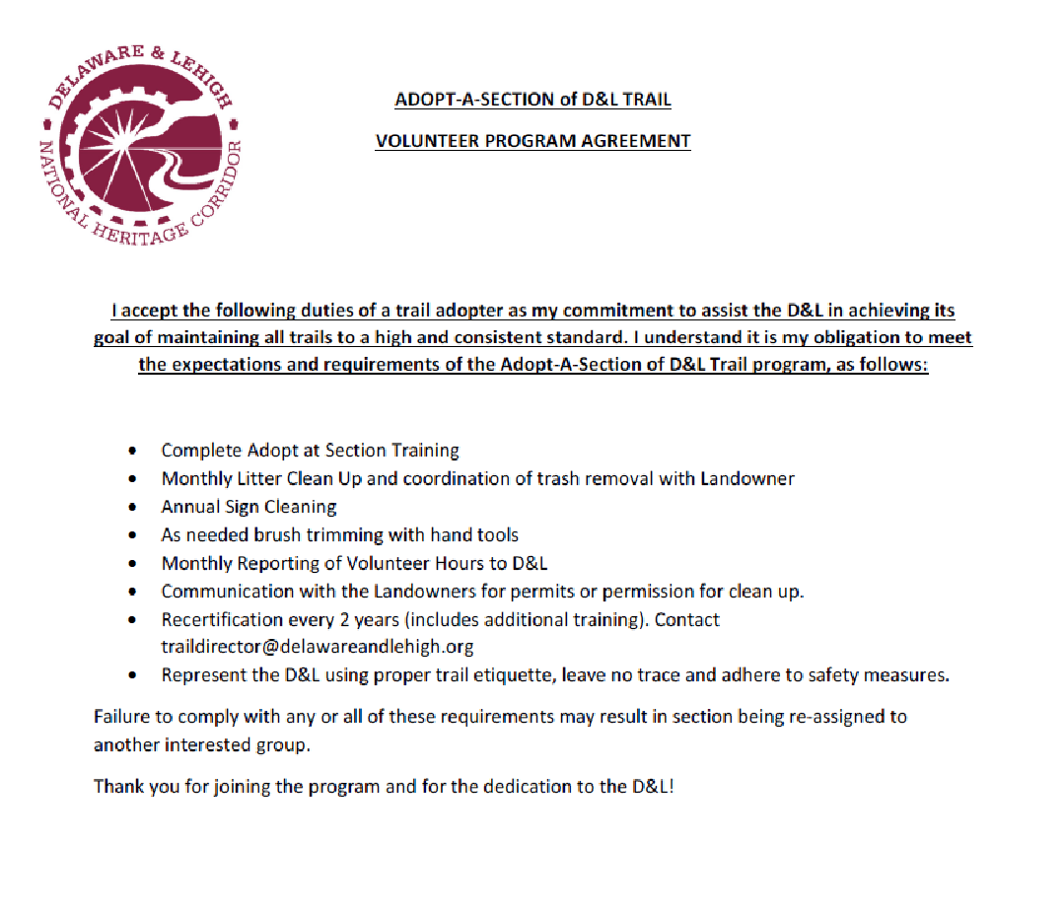
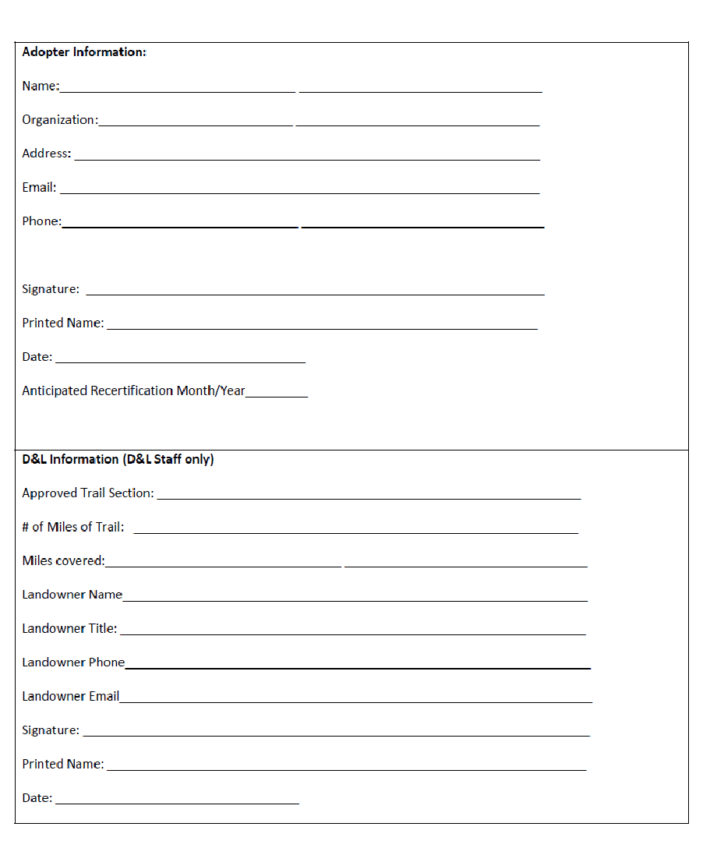
Adopt-A-Section
Agreement:
Notes:
Liz

Slide 19
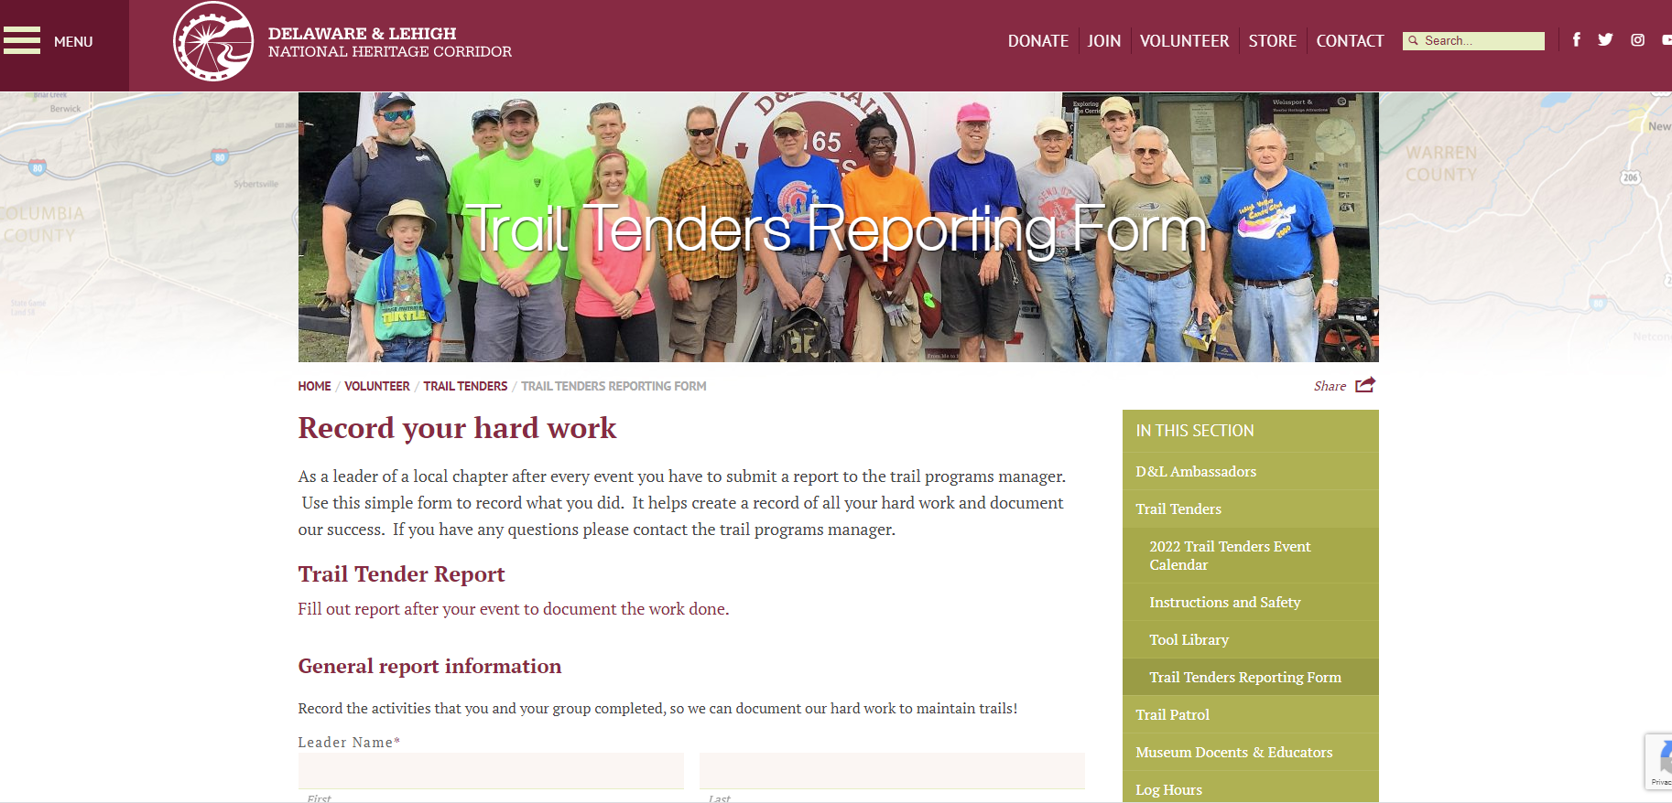
Adopt-A-Section
REPORTING FORMS- After each clean up
https://delawareandlehigh.org/volunteer/trail-tenders/trail-tenders-reporting-form/
Notes:
Liz

Slide 20
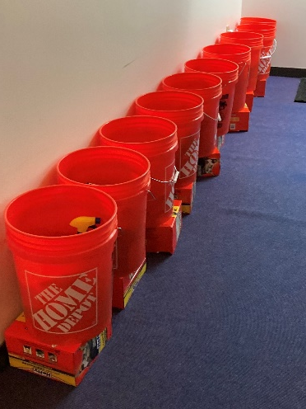
Adopt A Section
WHAT'S IN YOUR GOODIE BAG?
First Aid Materials
3 Regional Brochures
Handout Folder
Proper Trail Etiquette
Typical Trail Cross Sections & Parameters
D&L Trail Project Status Map
Lehigh Valley Wildlife Contacts
Sign Cleaning Kit
Trash Bags, Gloves, Goo Gone, Marine Wax, Clean Green, Graffiti Wipes, sponges and more!
Notes:
Liz

Slide 21
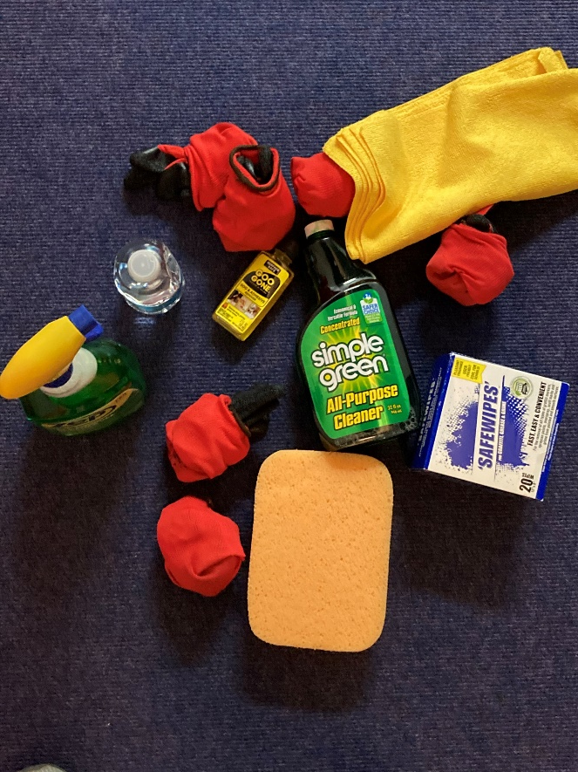
For more information: Liz Rosencrans Director of Trails and Conservation 610-984-4752 trailsdirector@delawareandlehigh.org Whitney Davison Education Manager 610-984-4753 education@delawareandlehigh.org
Review and Sign Program Agreements
QUESTIONS? DISCUSSION?
Notes:
Claire - Thank you – looking forward to discussing next steps more

